Slide 1

DateCoin
Team 1: Michael De Paula, Jeff Berger, Julian Martinez, Manny Russell, Emmanuel Henao & Mitchel Voloshin

Slide 2
Motivation & Summary
Goal:
We wanted to create a Decentralized Dating Application that provides users with a better and more secure experience than traditional dating platforms. Many dating apps today are filled with bots, subpar filtering and limited profile information. By offering a more secure online dating experience we are hoping users will be more comfortable in sharing additional information which will in turn lead to better filtering for matching.
Method:
Create a smart contract on the Ethereum network.

Slide 3
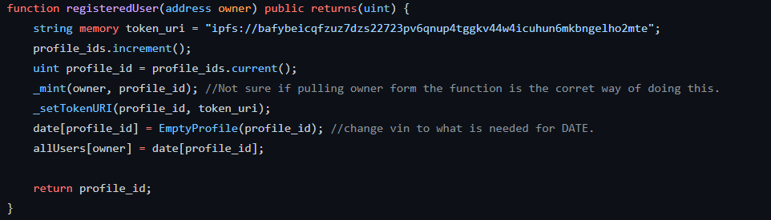
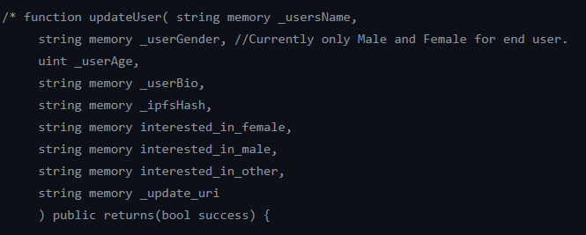
Smart Contract Functionality
Register User Function:
Mints Token
Combines token with User Profile
Update User Function:
Name
Bio
Age
Location
Interests
Update Picture

Slide 4
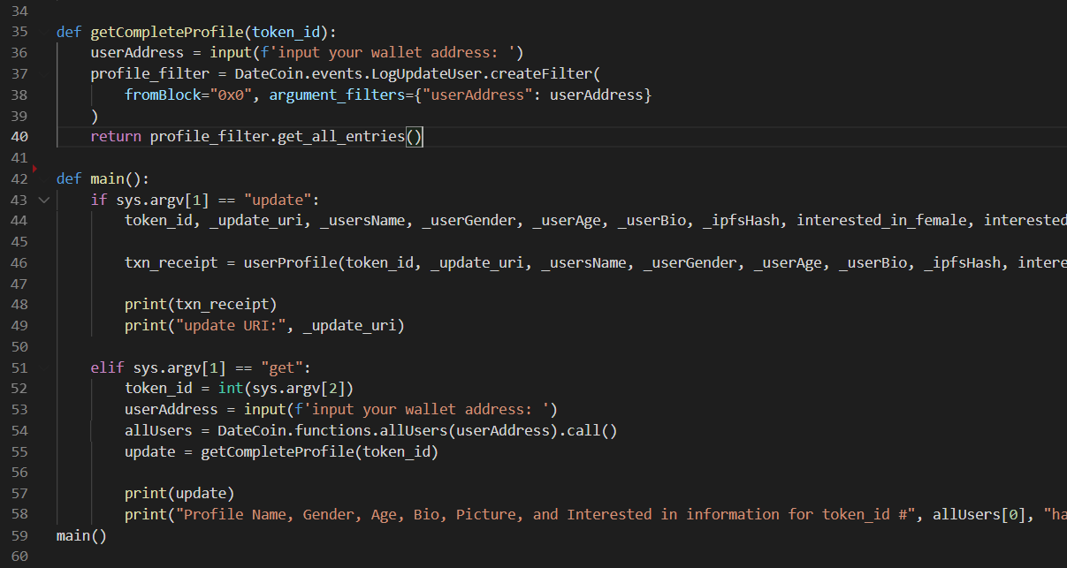
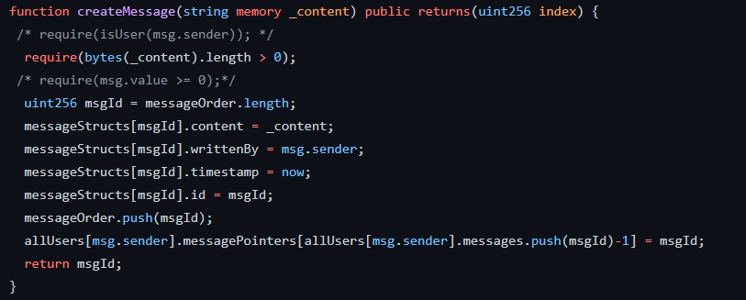
Smart Contract Functionality (Continued)
Profile Filter Function:
LogUpdateUser event from solidity
Creates Filter of Token Ids.
Messaging Function:
Message connections
Like comments
Unlike comments

Slide 5
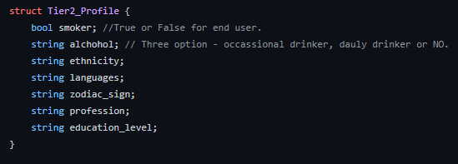
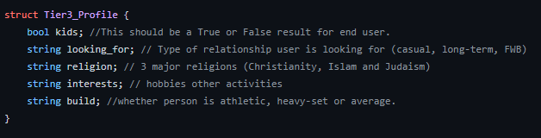
Profile Tiers for Filtering
Profile Tier 2
Smoker
Alcohol
Ethnicity
Languages
Zodiac Sign
Profession
Education level
Profile Tier 3
Kids
Looking for
Religion
Interests
Build

Slide 6
Deployment

Slide 7
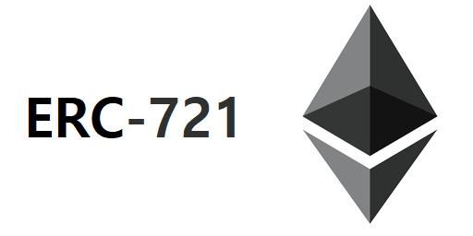
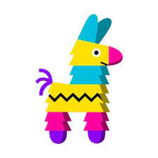
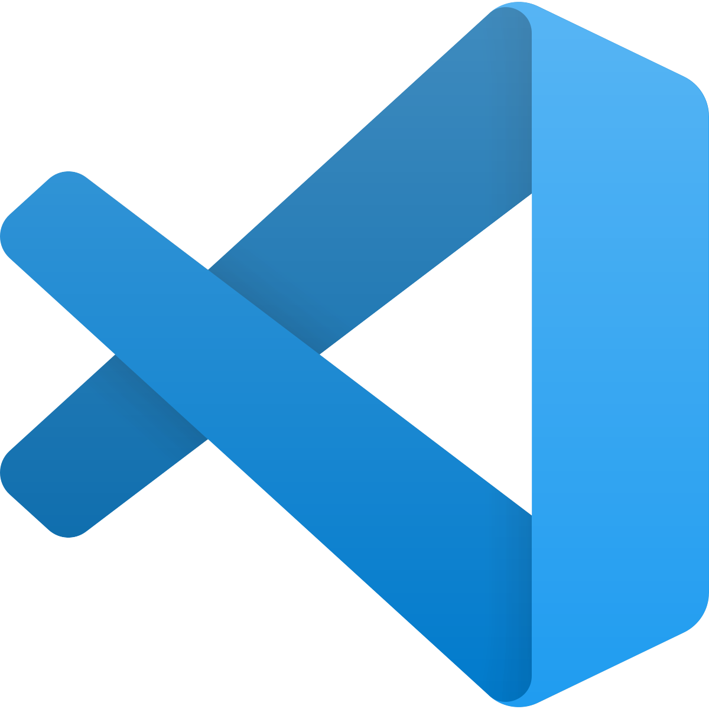
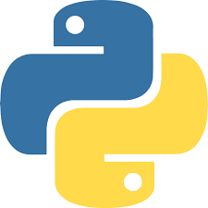
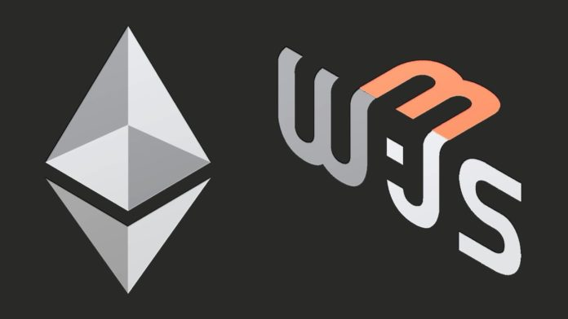
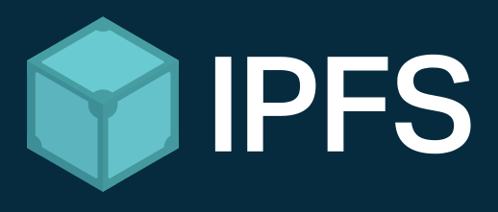
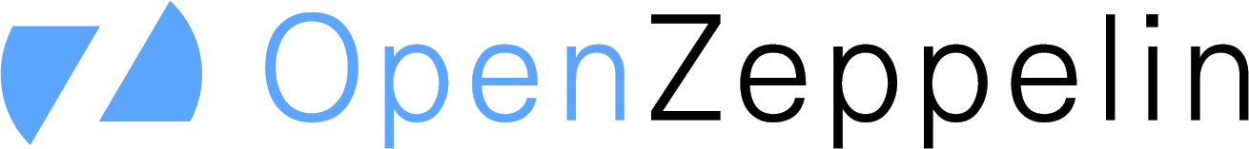
Tokens & Dependencies
ERC 721
VS Code
SYS
Pin Json to IPFS
Init Contract
Web3
Python
Pinata

Slide 8
Obstacles Faced
Sending private messages.
Providing filtering capabilities.
Limited time developing a Front End Software.
Keeping contract under 24 KB.
Gas Fees.
Length of code.

Slide 9
Conclusion
In Conclusion, we were able to compile and deploy the solidity contracts. We were able to register a user, update a user, and activate a user using the deployment feature within solidity.
In the future, we would like to build a full front-end GUI for the end user. We tried building an interactive prompt from python for use within terminal, this was partially successful as additional coding was required to connect other functions from solidity to Python.
We also would like to have a full deployment of tokens for every tier of profiles that are available to users within a public blockchain network.

